Slide 1

TONE CONTROL FOR GUITAR AMPLIFIER USING OPAMP 741
NAME | SRN
MADHUMITHA | PES2UG19EC110
SNIGDHA REDDY | PES2UG19EC144
NANDITHA K | PES2UG19EC078
NIKSHITHA | PES2UG19EC087

Slide 2
LIC FINAL PROJECT
GROUP-3

Slide 3

TOPIC
TONE CONTROL CIRCUIT
PRE AMPLIFIER
POWER AMPLIFIER
SPEAKER
THE TONE CONTROL CIRCUIT IS USED AS A COUPLE BETWEEN PRE-AMPLIFIER & POWER AMPLIFIER
TONE CONTOL IS BASICALLY AN EQUALIZER THAT MAINTAINS THE AUDIO OUTPUT EFFECT AT MAXIMUM REQUIRED FREQUENCY SHAPE AS LISTENER’S CHOICE

Slide 4
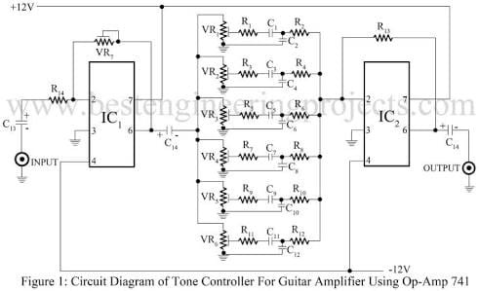

Slide 5
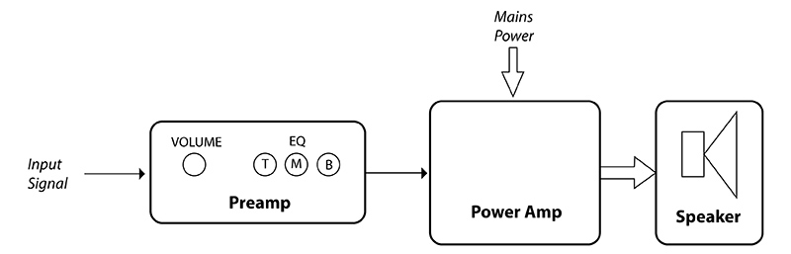
The preamp contains the circuitry that is primarily responsible for shaping the guitar sound and delivering it to the power amp in an optimal form. Almost all of the controls on the front panel of the guitar amp (gain, bass, mid, treble, volume etc.) are controlling the circuitry within the preamp.
2) The power amp receives the signal from the preamp. It then outputs a much larger version of the signal with voltage high enough to drive a speaker.
3) The speaker is a transducer system that turns electrical energy (from the power amp) into audible sound.

Slide 6
PRE AMPLIFIER
A preamplifier circuit suitable for high impedance pickups.
The circuit is based on a uA 741 op-amp.
The IC1 is wired as a non-inverting amplifier.
The amplifier can be powered from a 12V battery or 12V DC power supply.
In Pre amplifier circuit opamp 741 acts as an non inverting amplifier.
In this the output signals of non inverting opamp is in phase with the input signal applied.

Slide 7
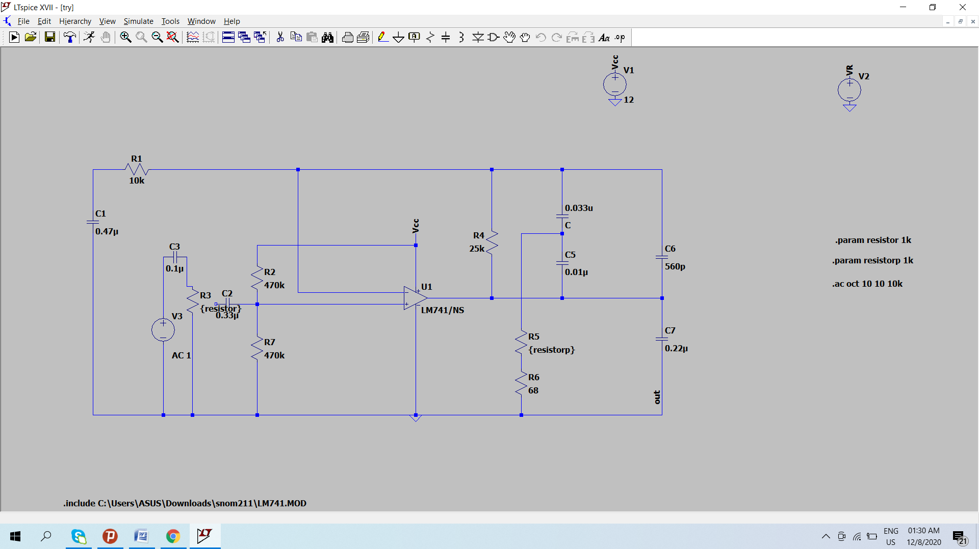

Slide 8
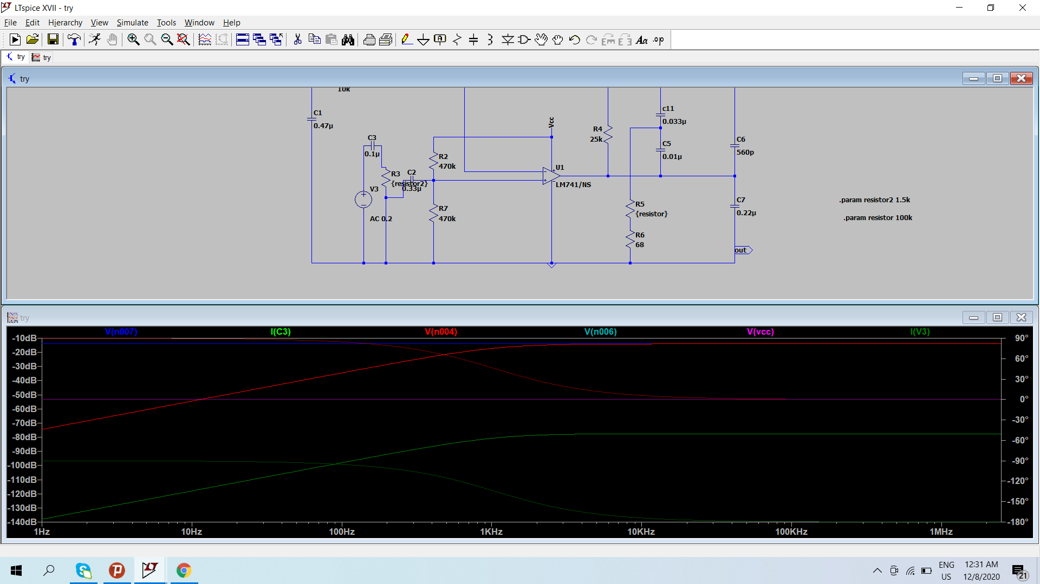

Slide 9
The preamp does this is by passing the input signal through circuitry called gain stages, usually at least 2. The main component of a gain stage is an active electronic component(like opamp 741), This component amplifies the miniscule input signal to a larger size and converts it to a much lower impedance.
A preamp also normally contains some simple noise filtering circuits. These remove electromagnetic interferences that attack the input signal on its way down the guitar cable and into the amplifier.

Slide 10
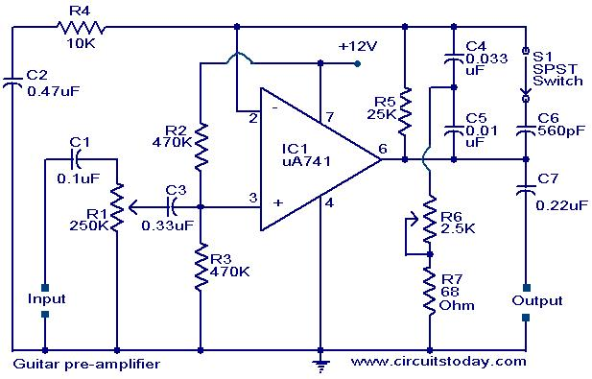
PRE AMPLIFIER:-

Slide 11
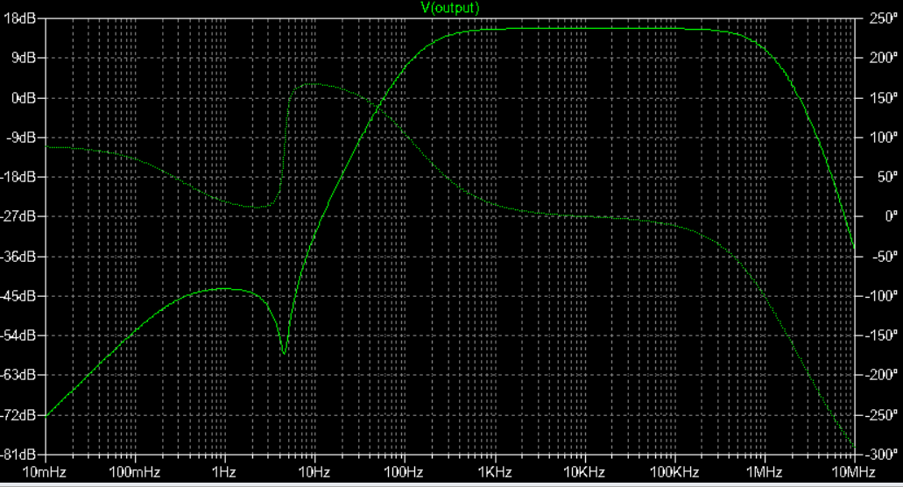

Slide 12

BASS & TREBLE CONTROL
TONE CONTROLLER INCLUDES BASS AND TREBLE CONTROL
THE BASS CONTROL IS NOTHING BUT A LOW PASS ELECTRONIC CIRCUIT WHICH FILTERS AND ALLOWS ONLY THE SPECIFIED LOW FREQUENCY SIGNALS TO PASS INTO THE AMPLIFIER STAGE
THE TREBLE CONTROL CIRCUIT WILL SWEEP OUT ALL SIGNALS WHICH ARE BELOW SPECIFIED FREQUENCY RANGE AND GET ONLY THE HIGH PITCHED SOUNDS

Slide 13
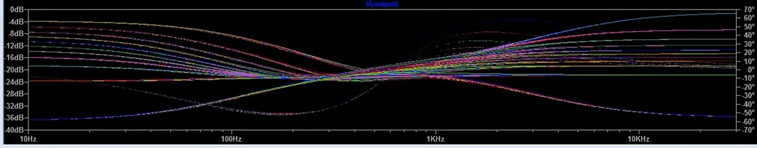
TONE CONTROL CIRCUIT _BASS AND TREBLE

Slide 14
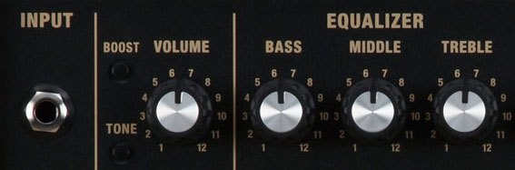

Slide 15
Power amplifier:
After increasing and passing through the pre-amplification stage, the guitar input signal strength is still relatively small. Now certainly more usable, it is not yet potent enough to drive a large speaker.
The function of the power amp is to output an electrical signal with the exact same waveform as the input signal. Boosted to a much higher voltage via power from the mains wall socket, the signal now becomes more usable. In simpler terms, the power amp takes the input signal and makes it much stronger. These devices are physically larger than in the preamp section, due to the much higher voltages they use.

Slide 16
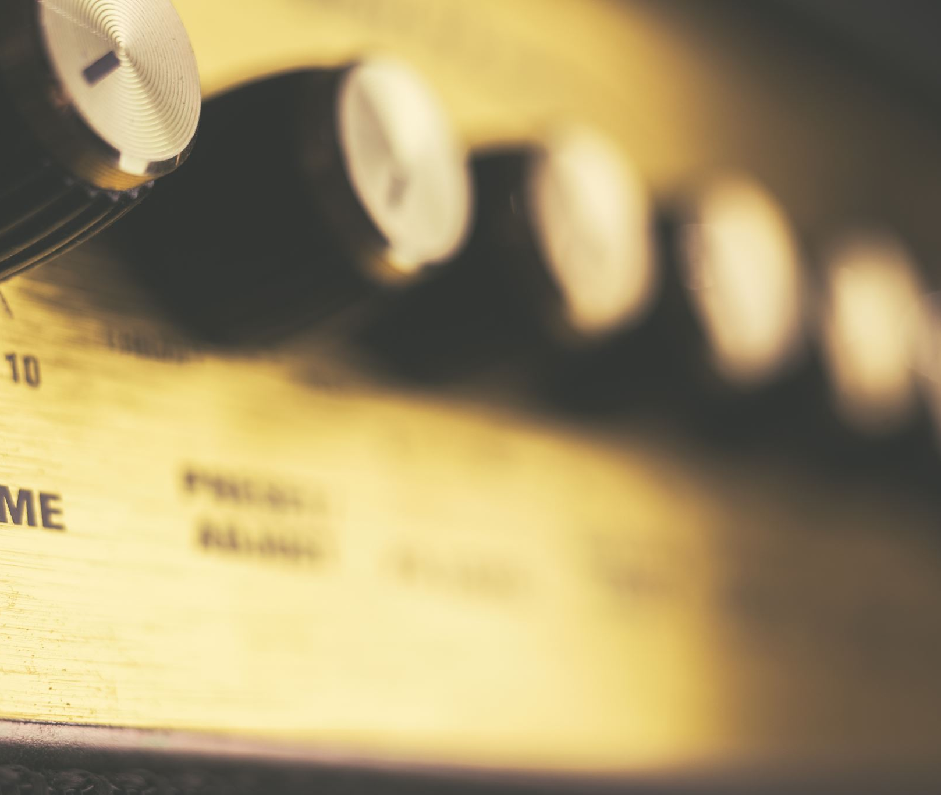
SPEAKER:
The speaker is an electronic transducer. It receives electrical energy and converts it into sound. As the part of the guitar amplifier that actually creates the amplifier’s sound, it is a hugely important.

Slide 17
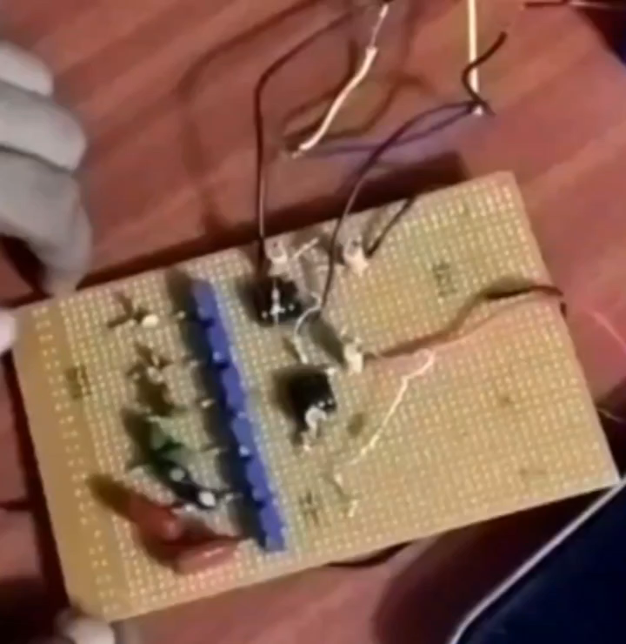

Slide 18
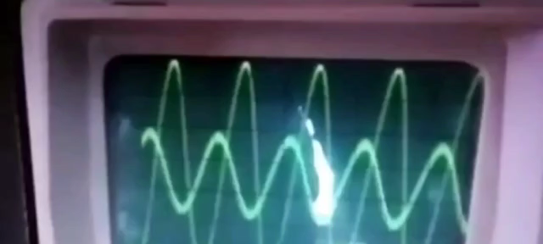

Slide 19
HIGH PASS FILTER
ƒc = 1/(2πRC) Here fc is the the cutoff frequency
Gain(dB)=20log(Vout/Vin)
|Vout|=|Vin|ωRC/√(1+ω^2R^2C^2)
LOW PASS FILTER
ƒc = 1/(2πRC) Here fc is the cut off frequency
Gain(dB)=20log(Vout/Vin)

Slide 20
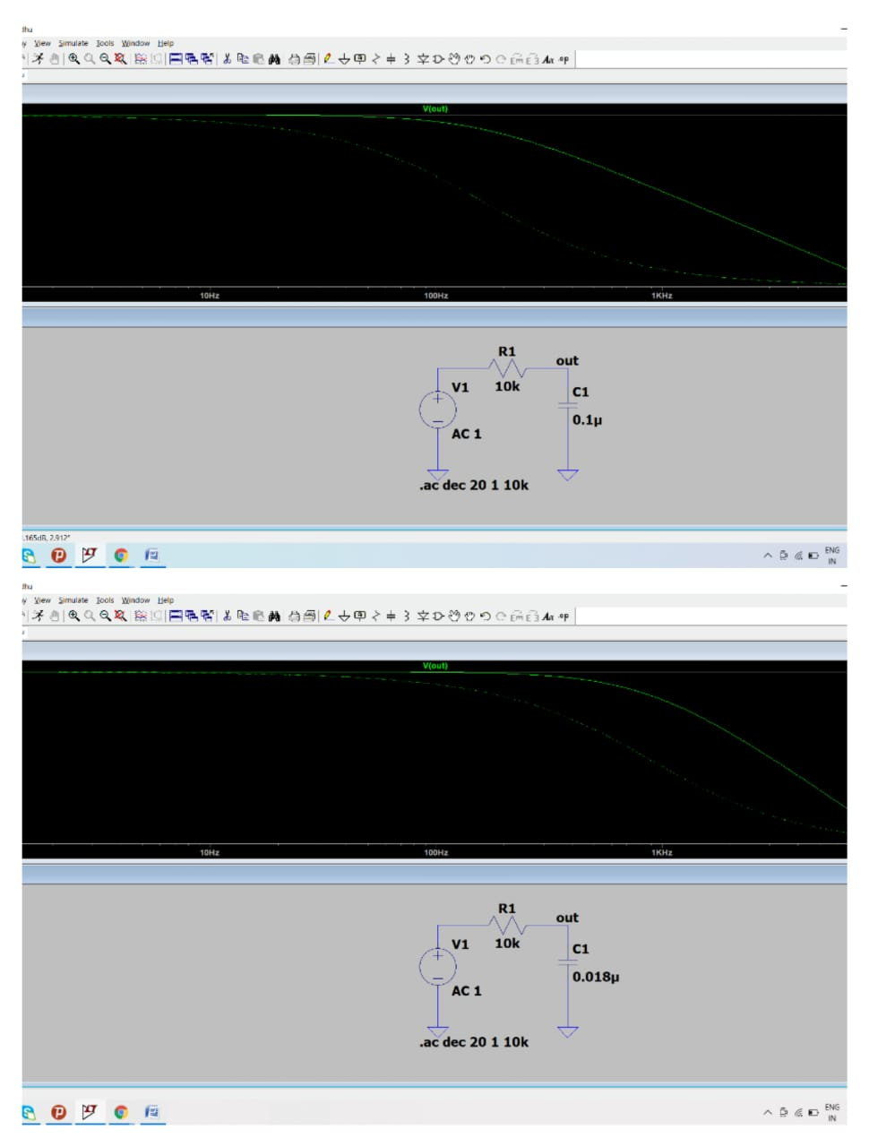

Slide 21
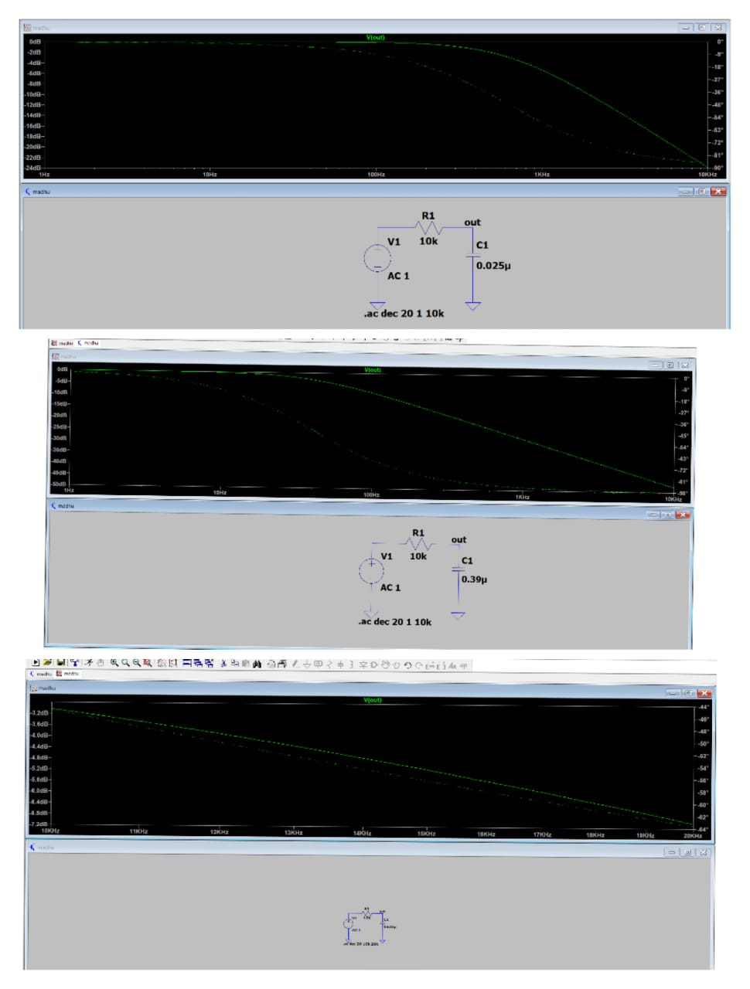

Slide 22
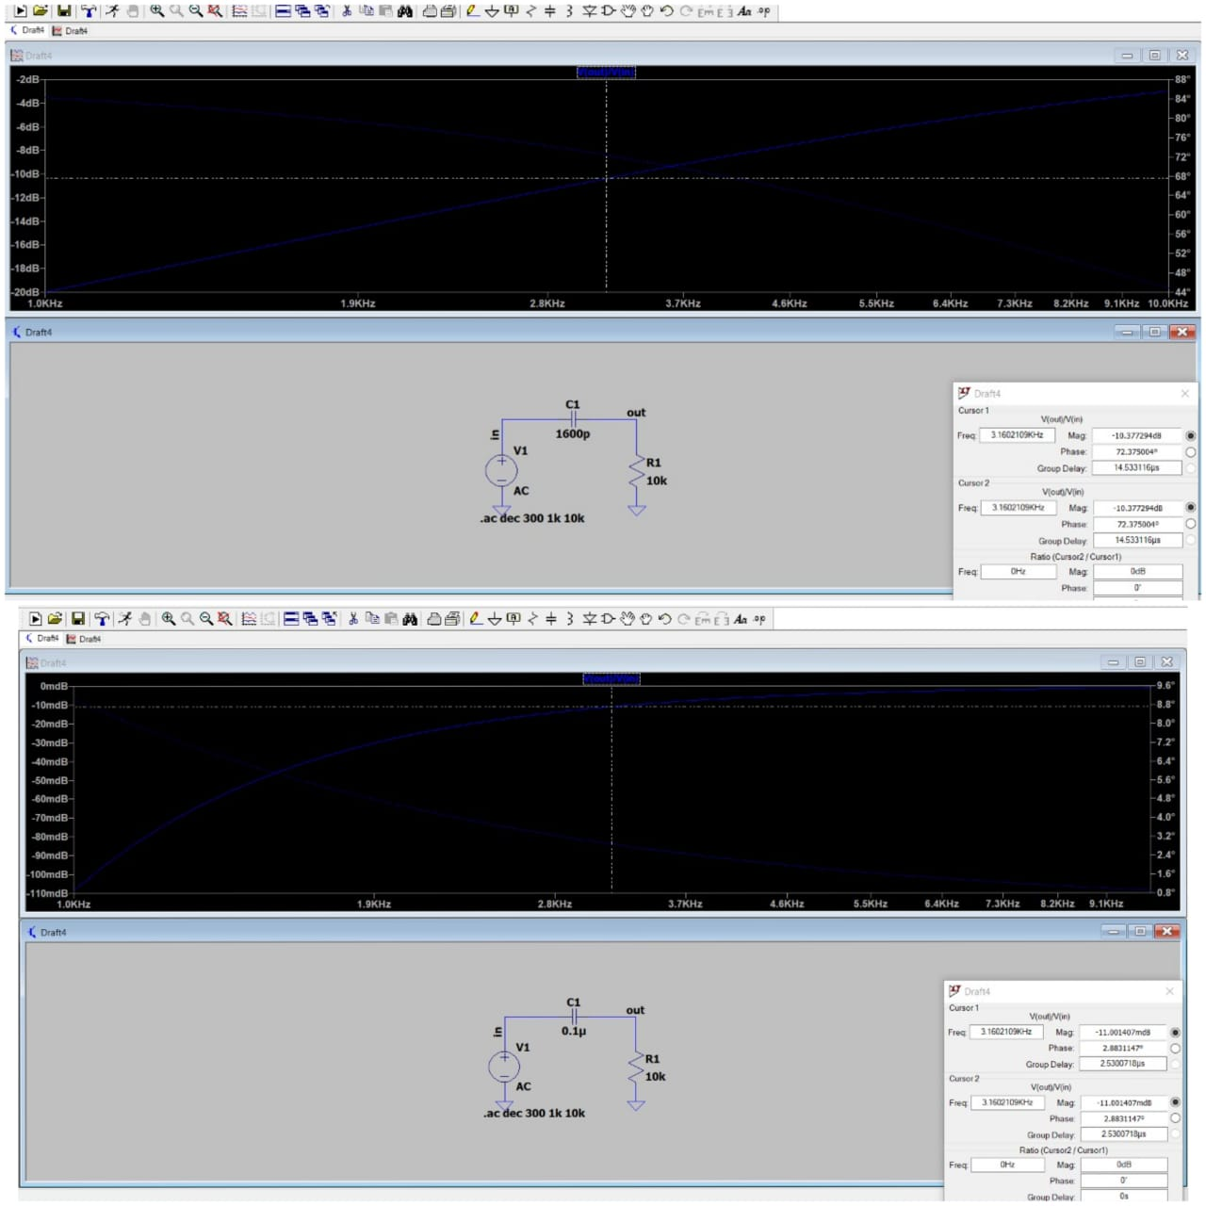

Slide 23
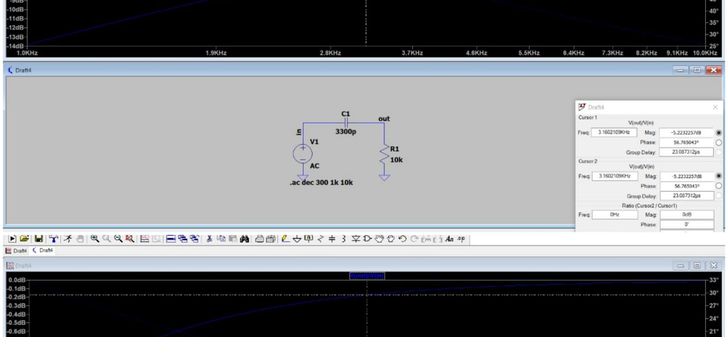

Slide 24
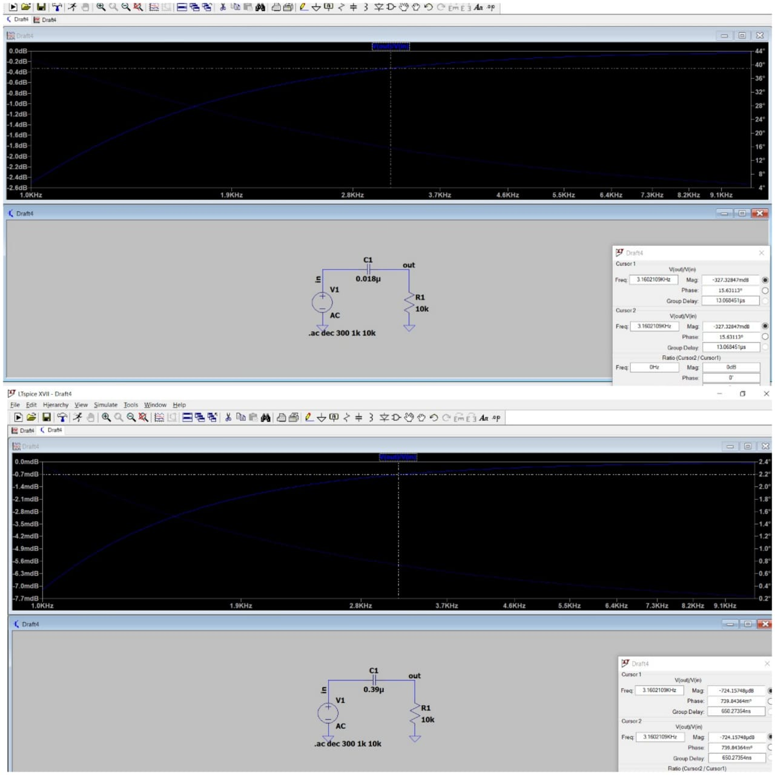

Slide 25
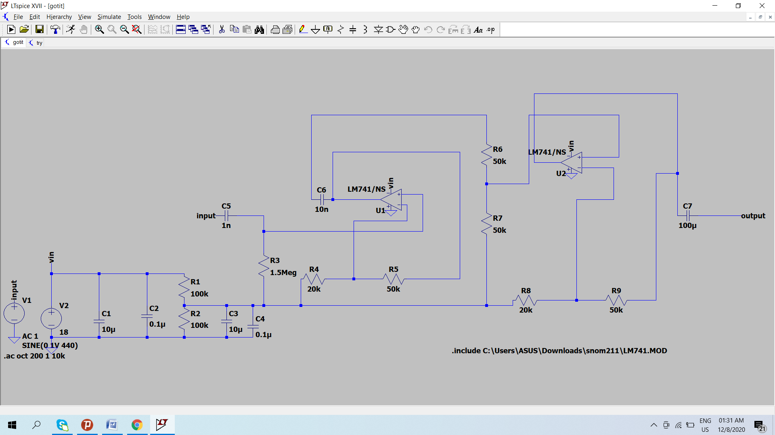

Slide 26
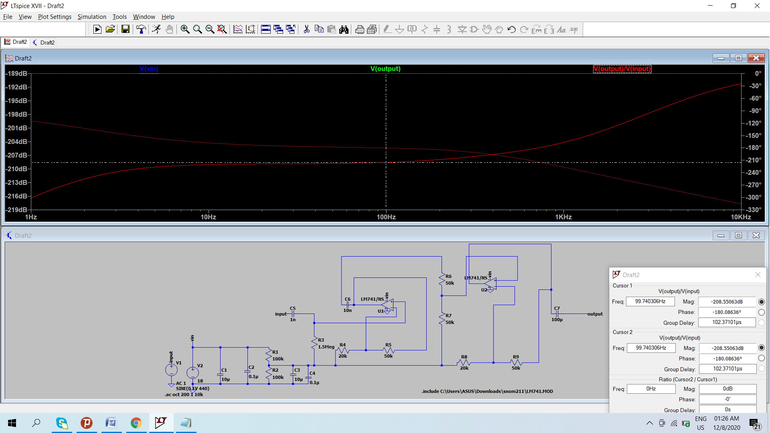

Slide 27
MAIN COMPONENTS
VARIABLE RESISTORS: The potentiometer is a variable resistor which allows you to control the amount of signal delivered to the capacitor.
VR1-VR6 = 10KΩ
RESISTORS AND CAPACITORS: The capacitor allows high frequencies to be passed to ground thus remove them from the signal being sent to the amplifier.
R1 – R12 = 10 KΩ
R13 = 1.2 KΩ
R14 = 47 KΩ
Capacitors
C1, C2 = 0.39 µF
C3, C4 = 0.1 µF
C5, C6 = 0.025 µF
C7, C8 = 0.018 µF
C9, C10 = 3300 pF
C11, C12 = 1600 Pf
C13, C14 = 5 µF, 25V

Slide 28
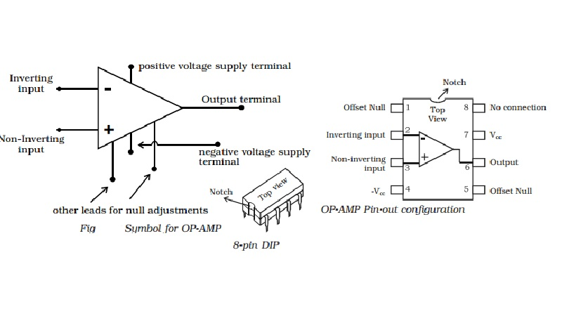
SYMBOL AND PIN DIAGRAM OF OPAM 741
PRE AMPLIFIER CONFIGURATION
V1= R2xVOUT/(R2+RF)
IDEAL SUMMING POINT: V1=VIN
VOLTAGE GAIN,A(V) IS EQUAL TO: VOUT/VIN
THEN, A(V)= VOUT/VIN=(R2+RF)/R2
TRANSPOSE TO GIVE A(V)= VOUT/VIN= 1+(RF/R2)
FREQUENCY OUT(Hz) | C | R
40 | 0.39µF | 10K
155 | 0.1µF | 10K
625 | 0.025µF | 10K
2.5K | 0.018µF | 10K
4.5K | 3300pF | 10K
10K | 1600pF | 10K
MIN FREQUENCY RESPONSE | MEAN FREQUENCY RESPONSE | MAX FREQUENCY RESPONSE
0 | 40 | 100
100 | 155 | 500
600 | 625 | 2.2K
2.2K | 2.5K | 4.2K
4.2K | 4.5K | 8.2K
8.2K | 10K | 12.25K

Slide 29
POWER AMPLIFIERS
The power amp receives the signal from the preamp. It then outputs a much larger version of the signal with voltage high enough to drive a speaker
This Amplifier is 12 watts and to operate this is use source of dual symmetric ± 12 volt. The 741 provides the required gain while the speaker unit driven by complementary Darlingtons T1, T2 and T3, T4. Input signal to the Darlington comes from the feed current 741. Since R6 is connected to earth, positive or negative current signal is also going through R4 or R5. The voltage drop across this resistance serves as the input signal to the transistor pairs. A common dc negative feedback from the collector junction with T2 and T4 stabilize the DC circuit and the junction point is maintained at zero volts. So, there is no coupling capacitor needed for the speaker.

Slide 30
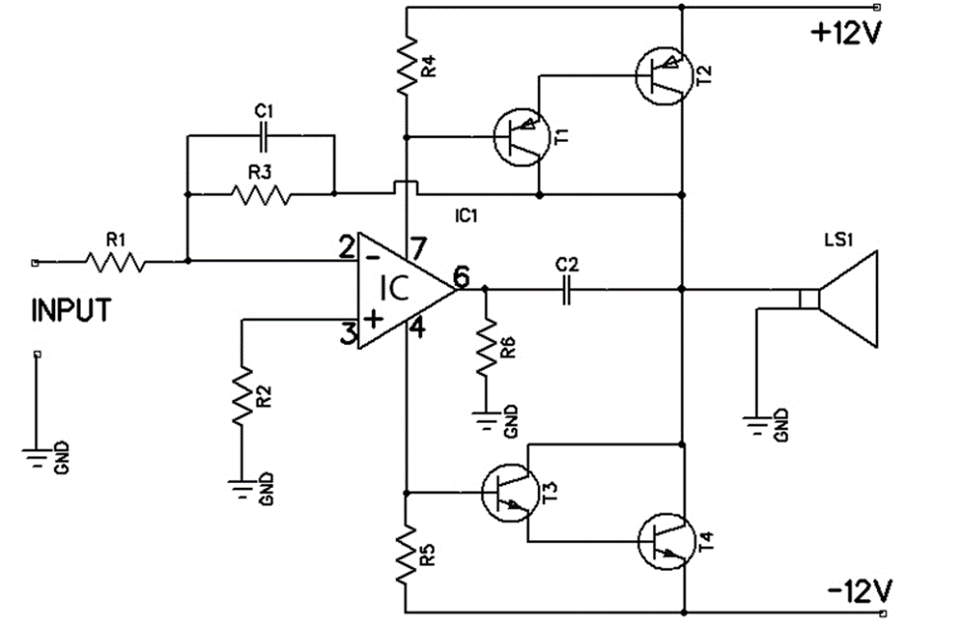
CIRCUIT DIAGRAM

Slide 31
LIST OF THE PARTS
R1 | 10k
R2 | 4.7KΩ
R3 | 270KΩ
R4 | 1k
R5 | 1k
R6 | 47Ω 1W
C1 | 50 pF
C2 | 0.01 mF
T1 | BC178
T2 | 2N6107
T3 | AC108
T4 | 2N5294
IC | LM741
LS1 | 50W 4Ω

